Slide 1
Basic Spring 5.0
Lesson 1: Introduction to Spring Platform and environment
Notes:
Add instructor notes here.

Slide 2
Lesson Objectives
In this lesson , you will learn about
Introduction to Spring
Spring 5 New Features
Spring Projects at a glance
Spring IO Platform
Spring Framework
Spring Boot
Notes:
Explain the lesson coverage

Slide 3

1.1 Introduction to Spring Platform and Environment
Spring is a Java platform that provides comprehensive
infrastructure support for developing Java applications with development tools.
Any application can benefit from Spring in terms of
Simplicity
Testability
Loose Coupling
Automation of deployment
Convention over configuration
Services to enable a cohesive technology experience not only for
the developers, but also for the businesses
Notes:
What is spring?
Spring is a Java platform that provides comprehensive infrastructure support for developing Java applications with development tools.
Any java application can benefit from Spring in terms of
Automation of deployment
Convention over configuration
Testing is simpler
Services to enable a cohesive technology experience not only for the developers, but also for the businesses
Addresses the complexity of enterprise application development

Slide 4
1.2 Spring 5 New Features
Baseline Upgrade
Reactive Programming Support
A functional web framework
Kotline Support
Dropped Features
Notes:
Baseline Upgrade
To build and run Spring 5 application, you will need minimum JDK 8 and Java EE 7. Previous JDK and Java EE versions are not supported anymore. To elaborate, Java EE 7 includes –
Servlet 3.1
JMS 2.0
JPA 2.1
JAX-RS 2.0
Bean Validation 1.1
Similar to Java baseline, there are changes in baselines of many other frameworks as well. e.g.
Hibernate 5
Jackson 2.6
JUnit 5
Tiles 3
Also, note down the minimum supported versions of various servers.
Tomcat 8.5+
Jetty 9.4+
WildFly 10+
Netty 4.1+
Undertow 1.4+
Spring 5 release has been very well aligned with JDK 9 release dates. The goal is for Spring Framework 5.0 to go GA right after JDK 9’s GA. Spring 5.0 release candidates are already supporting Java 9 on classpath as well as modulepath.
Spring 5 has baseline version 8, so it uses many new features of Java 8 and 9 as well. e.g.
Java 8 default methods in core Spring interfaces
Internal code improvements based on Java 8 reflection enhancements
Use of functional programming in the framework code – lambdas and streams
Along with the increase in baseline versions for Java, Java EE and a few other frameworks, Spring Framework 5 removed support for a few frameworks. e.g.
Portlet
Velocity
JasperReports
XMLBeans
JDO
Guava

Slide 5
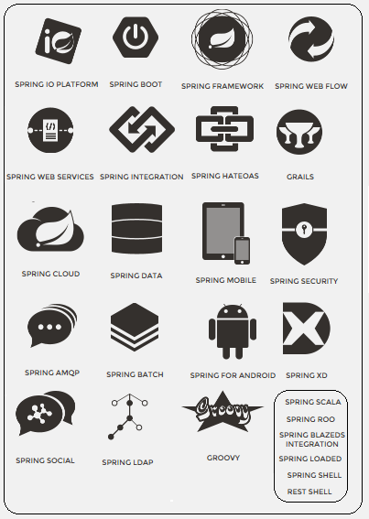
1.3 Spring Projects At a Glance
Spring is modular by design
Spring has many projects which helps us to build modern applications with any infrastructure needs such as
Simple Configuration
High Security
Connectivity to Big Data
Development of Web apps
Connectivity to cloud services
Integration with any
framework.
Notes:
Spring IO platform includes Foundation Layer modules and Execution Layer domain-specific runtimes (DSRs)
Spring Boot favors convention over configuration and is designed to get you up and running as quickly
Spring Framework provides a comprehensive programming and configuration model for modern Java-based enterprise applications on any kind of deployment platform
Spring Web Flow builds on Spring MVC and allows implementing the "flows" of a web application
Spring Web Services (Spring-WS) is a product of the Spring community focused on creating document-driven Web services
Spring Integration extends the Spring programming model to support the well-known Enterprise Integration Patterns
Spring eXtreem Data : The project‘s goal is to simplify the development of big data applications. the core Spring APIs into a cohesive and versioned foundational platform for modern applications.
Spring Reactive : Reactive Streams, for handling live data (provide a standard for asynchronous stream processing with non-blocking back pressure on the JVM)
Hypermedia As The Engine Of application State : REST client interacts with a network application entirely through hypermedia provided dynamically by application servers. A REST client needs no prior knowledge about how to interact with any particular application or server beyond a generic understanding of hypermedia, in contrast with SOA.
Spring HATEOS :link creation and representation assembly
Microservices (wiki) : Software architecture design pattern, in which complex applications are composed of small, independent processes communicating with each other using language-agnostic APIs. These services are small, highly decoupled and focus on doing a small task.
Spring Boot : It’s a new framework designed to simplify the bootstrapping and development of a new Spring application with opinionated approach to configuration, freeing developers from the need to define boilerplate configuration.
Spring Cloud : Provides tools for developers to quickly build some of the common patterns in distributed systems (e.g. configuration management, service discovery, circuit breakers, intelligent routing, micro-proxy, control bus, one-time tokens, global locks, leadership election, distributed sessions, cluster state).

Slide 6

1.4 Spring IO Platform
Brings together the core Spring APIs into a cohesive
platform for modern applications.
Spring IO Platform has 3 layers:
Spring IO Foundation layer
A cohesive set of APIs and embeddable runtime components that enable to build applications
Spring IO Coordination layer
Provides API’s to connect to cloud services
Spring IO Execution layer
Provides DSR(Domain-Specific Runtime) for applications built using IO Foundation modules.
Helps to avoid deployment to an external container like Tomcat
Notes:
Spring IO Platform brings together the core Spring APIs into a cohesive platform for modern applications.
For example, there are many existing applications designed based on the core Spring Framework, and customers may want these applications to be upgraded with features like adding an OAuth secured REST service, connect to cloud services, Moving data into Hadoop, bridging multiple data stores, etc.. In order to upgrade applications including all the services use Spring IO Platform modules.
Spring IO Platform is comprised of 3 layers:
Spring IO Foundation layer
A cohesive set of APIs and embeddable runtime components that enable to build applications
IO Coordination
Provides API’s to connect to cloud services with Spring Cloud.
IO Execution
Provides DSR(Domain-Specific Runtime) for applications built using IO Foundation modules.
Helps to avoid deployment to an external container like Tomcat
Spring IO execution includes three DSRs: Spring XD, Spring Boot, and Grails.

Slide 7
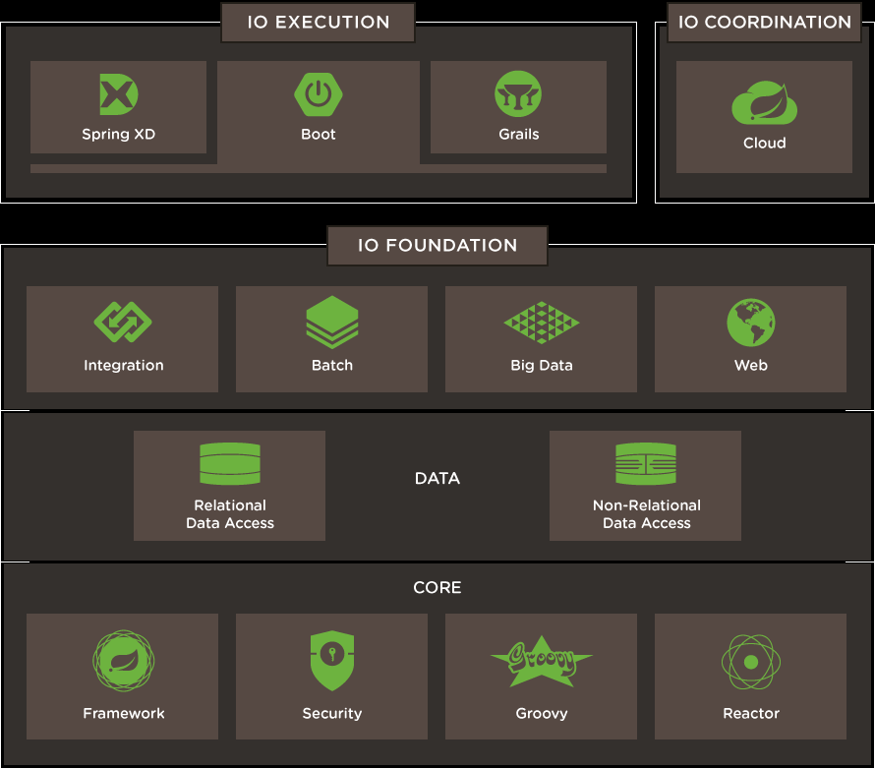
1.4 Spring IO Platform
Notes:
Spring IO Execution Layer:
Spring XD provides a powerful runtime and DSL for describing big data ingestion and analytics, export, and Hadoop workflow management.
Spring Boot reduces the effort needed to create production-ready, DevOps-friendly, XML-free Spring applications. Spring Boot dynamically wires up beans and settings and applies them to your application context
Grails provides a productive and stream-lined full-stack web framework by combining the power of the Spring IO Foundation components with a set of comprehensive Groovy-based DSLs.
Spring IO Coordination Layer:
Spring Cloud is an open-source library with which an application can be connected with cloud environment. For example, Instead of creating data source object to connect with relational databases use Spring cloud which does all these work(like access and configure service connectors) by using cloud connector.
Spring IO Foundation Layer
Spring Integration extends the Spring programming model to support the well-known Enterprise Integration Patterns.
Spring Batch is a lightweight, comprehensive batch framework designed to enable the development of robust batch applications vital for the daily operations of enterprise systems.
Spring Big Data is used to simplify the development of big data applications.
Spring Web builds on Spring MVC and allows implementing the "flows" of a web application.
Spring data makes it easy to use new data access technologies, such as non-relational databases, map-reduce frameworks, and cloud based data services.
Spring Framework provides a comprehensive programming and configuration model for modern Java-based enterprise applications on any kind of deployment platform.
Spring security helps us to secure spring based applications since it is a powerful and highly customizable authentication and access-control framework.
Spring groovy can be used to integrate with groovy for building high-productivity dynamic application.
Spring Reactor is a Reactive Streams, for handling live data (provide a standard for asynchronous stream processing with non-blocking back pressure on the JVM)
Give an overview of different modules available in 3 layers of IO platform.
Spring Boot will be explained with example. Spring Framework will be explained in detail further to this.

Slide 8
1.4.1 Spring Framework
Spring Framework is an open source framework
Addresses the complexity of enterprise application development
Spring Framework provides programming & configuration model with Lightweight solution to build enterprise-ready applications
Any java application can benefit from Spring framework in terms of simplicity, testability and loose coupling
Notes:
Spring makes it easy to use POJO (Plain Old Java Objects) to achieve things that were previously only possible with EJBs. However, Spring’s usefulness isn’t restricted to server-side development. Any java application can benefit from Spring in terms of simplicity, testability and loose coupling.

Slide 9

1.4.2 Spring Boot
Spring Boot ships with command line tool
for executing spring applications
Spring Boot dynamically wires up beans
and settings and applies them to your
application context.
Advantages of using Spring Boot are:
No requirement for XML configuration
Annotation based configuration
Has embedded server
Reduces boiler plate code
Simplifies testing
Simplifies application maintenance
Reduces the size of build file

Slide 10
Lesson Summary
In this lesson, you have learnt about
What is Spring and why spring?
List of spring projects
Spring IO platform
Overview of Spring Framework and Spring Boot
Notes:
Thus we have seen that Spring is the most popular and comprehensive of the lightweight J2EE frameworks that have gained popularity since 2003.
We saw how Spring is designed to promote architectural good practice. A typical spring architecture will be based on programming to interfaces rather than classes.
We have seen what is Inversion of control and dependency injection.
We also saw Bean containers and lifecycle of beans in containers. We saw how to hook into the lifecycle of a bean and make it aware of the Spring environment.

Slide 11
Review Questions
Question 1: Spring IO _________ layer provides
API to connect to cloud services
Option 1: Foundation
Option 2: Coordination
Option 3: Execution
Question 2: Spring Boot reduces the effort needed
to create production-ready, DevOps-friendly, XML-
free Spring applications.
Option 1: True
Option 2: false
Notes:
Question 1: Option 2
Question 2: True

